Slide 1
NAPLAN
Topic: NAPLAN Prep
EQ: How else can we write very small numbers?
Mrs Stretch
Year 9

Slide 2
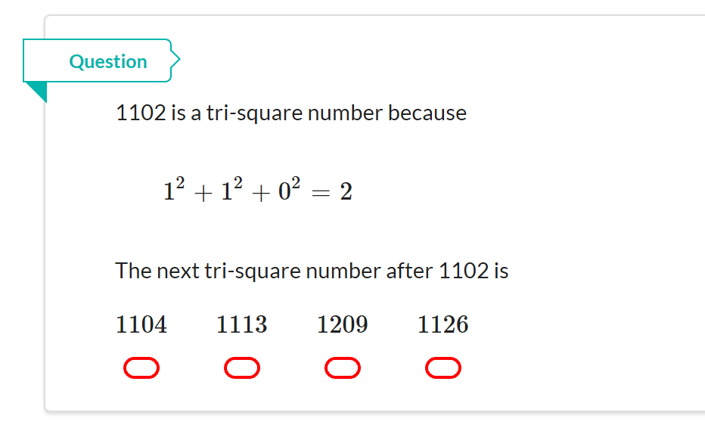
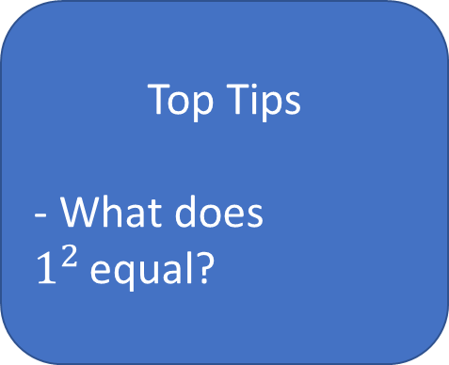
NAPLAN Question
Top Tips
- What does $1^{2 }$equal?

Slide 3
Very small numbers!
How wide is an atom?
0.000 000 000 1 metres wide!

Slide 4
Standard Form for small numbers
Move the point to get a
number between 1 and 10
.
0.000 000 000 1
The point moved 10 places. Negative sign for small numbers.

Slide 5
Standard Form for small numbers
Move the point to get a
number between 1 and 10
.
0.000 000 76
The point moved 7 places. Negative sign for small numbers.

Slide 6
Standard Form for small numbers
Move the point to get a
number between 1 and 10
0.000 001 93
.
The point moved 6 places. Negative sign for small numbers.

Slide 7
Exercise 4
(1) 0. 000 3
(2) 0.000 07
(3) 0.000 45
(4) 0.003 4
(5) 0. 000 724
(6) 0.000 000 494
(7) 0.000 095
(8) 0.000 000 098
(9) 0.000 1 03
(10) 0.000 000 000 66

Slide 8
Changing back small numbers
-3 so remember to move point left for small numbers.
Hint:
Add 3 zeros to the left of the number.
000
2
.
.
= 0.002

Slide 9
Changing back small numbers
-3 so remember to move point left for small numbers.
Hint:
Add 5 zeros to the left of the number.
00000
8.6
.
= 0.000 086

Slide 10
Changing back small numbers
-3 so remember to move point left for small numbers.
Hint:
Add 6 zeros to the left of the number.
000000
5.16
.
= 0.000 00516

Slide 11
Exercise 5
(1)
(2)
(3)
(4)
(5)
(6)
(7)
(8)
(9)
(10)
= 0.000 5
= 0.000 09
= 0.005 8
= 0.000 000 62
= 0.000 006 45
= 0.000 000 53
= 0.000 009 17
= 0.002 12
= 0.000 020 3
= 0.000 000 006 032

